Slide 1
Monday, 1/31/22
Any Questions?
Project 1
Weekly Assignments
Office Hours, Examity
Module Topics
Module 4 | Bag ADT – Array Based (Ch. 2)
Module 5 | Bag ADT – Linked Data (Ch. 3)
Module 3 | Generics

Slide 2
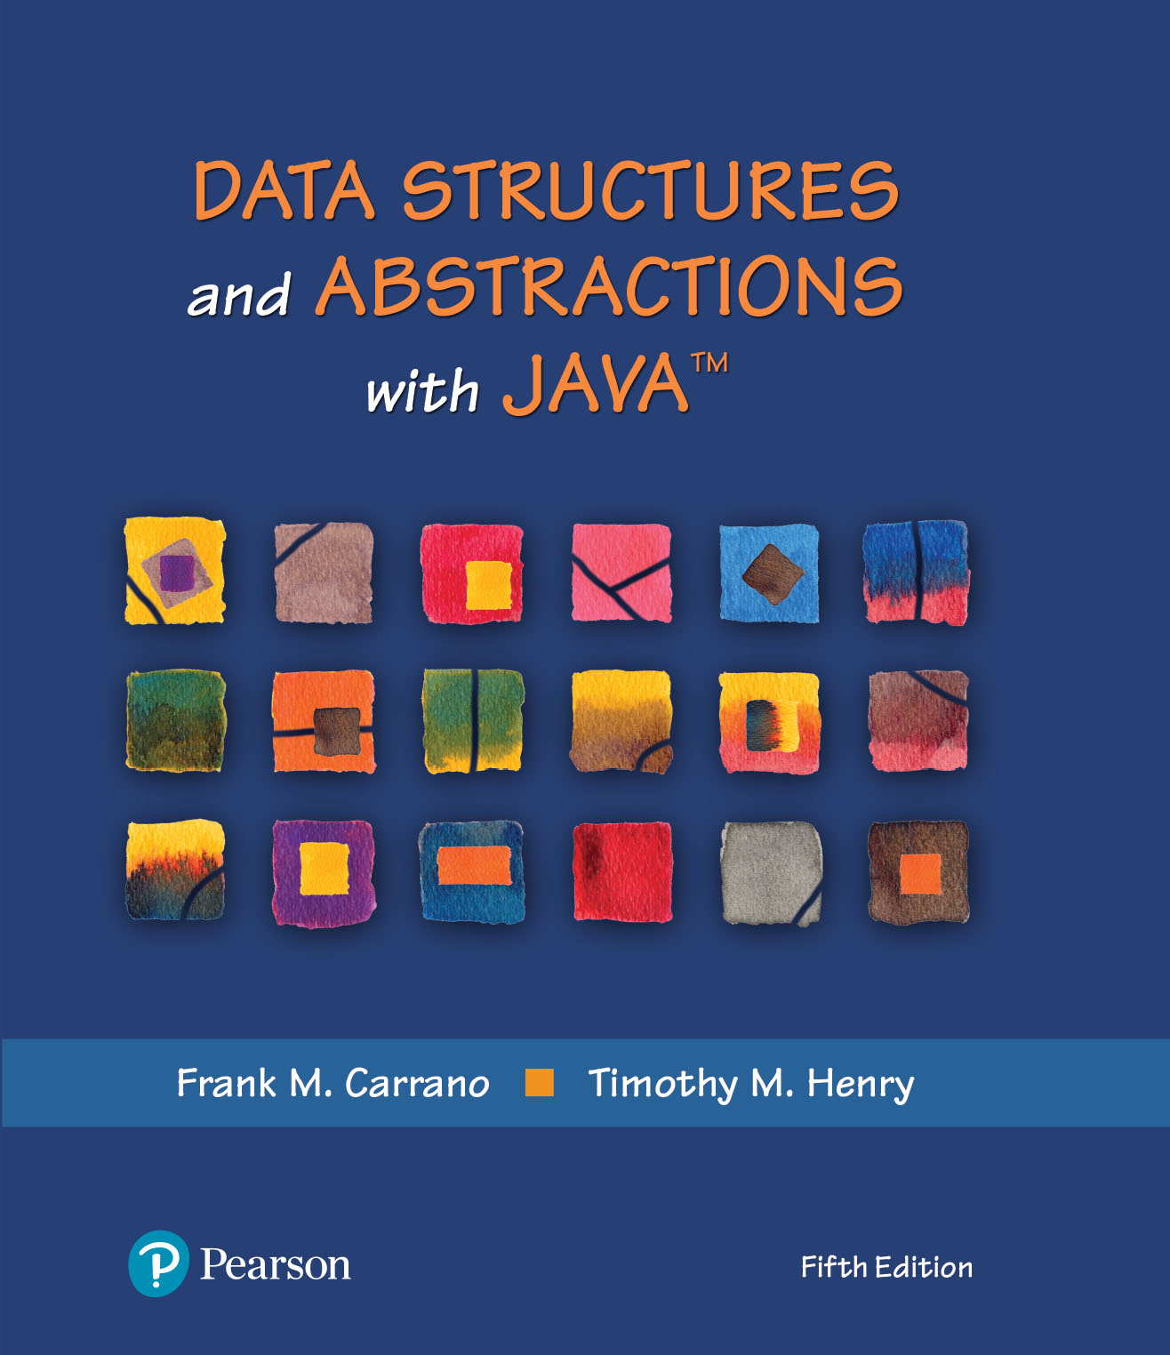
Module 4
Chapter 2 - Bag Implementations
that Use Arrays

Slide 3
Video Notes
An Array-Based ADT Bag
https://mediaplayer.pearsoncmg.com/assets/secs-vn-ch02a-an-array-based-adt-bag
A Resizable Bag
https://mediaplayer.pearsoncmg.com/assets/secs-vn-ch02b-a-resizeable-bag
Notes:
To maximize your learning experience, prepare for class prior each week

Slide 4
Bag | What vs. How
ADT Bag
What’s a bag?
What are the operations?
Bag Interface
ADT vs. Data Structure
One can build a bag using any programming language
Learn to build Java collections (in 204)
How (implementation details)
Create a bag using an array implementation (as the underlying structure) first
Then create the same bag using a linked implementation instead
Internally, they are vastly different
However, it’s still a bag to anyone who is using our bag
Notes:
Q: What are we trying to build?
A: Bag
Q: How are we going to build it?
A: Using an array as our implementation
Looking ahead, we should consider using ArrayList instead of an array. It’s just easier once we start dealing with generics

Slide 5
Bag Interface (1 of 2)
/** An interface that describes the operations of a bag of objects. */
public interface BagInterface<T>
{
/** Gets the current number of entries in this bag.
@return The integer number of entries currently in the bag. */
public int getCurrentSize();
/** Sees whether this bag is empty.
@return True if the bag is empty, or false if not. */
public boolean isEmpty();
/** Adds a new entry to this bag.
@param newEntry The object to be added as a new entry.
@return True if the addition is successful, or false if not. */
public boolean add(T newEntry);
/** Removes one unspecified entry from this bag, if possible.
@return Either the removed entry, if the removal.
was successful, or null. */
public T remove();
Notes:
This is the Bag interface that we were Why are we talking about an interface?

Slide 6
Bag Interface (2 of 2)
/** Removes one occurrence of a given entry from this bag, if possible.
@param anEntry The entry to be removed.
@return True if the removal was successful, or false if not. */
public boolean remove(T anEntry);
/** Removes all entries from this bag. */
public void clear();
/** Counts the number of times a given entry appears in this bag.
@param anEntry The entry to be counted.
@return The number of times anEntry appears in the bag. */
public int getFrequencyOf(T anEntry);
/** Tests whether this bag contains a given entry.
@param anEntry The entry to find.
@return True if the bag contains anEntry, or false if not. */
public boolean contains(T anEntry);
/** Retrieves all entries that are in this bag.
@return A newly allocated array of all the entries in the bag.
Note: If the bag is empty, the returned array is empty. */
public T[] toArray();
} // end BagInterface

Slide 7

ADT Bag | (Fixed-Size) Array Implementation
Notes:
Why using an array?

Slide 8
ArrayBag | Fixed Size & Generic
ArrayBag
-bag: T[] -numberOfEntries: integer -DEFAULT_CAPACITY: integer
+getCurrentSize(): integer +isEmpty(): boolean +add(newEntry: T): boolean +remove(): T +remove(anEntry: T): boolean +clear(): void +getFrequencyOf(anEntry: T): integer +contains(anEntry: T): boolean +toArray(): T[] –isArrayFull(): boolean
Notes:
We are building an ArrayBag that can support any data type. T is a (data type) placeholder
What’s T[]?
Why T[]?

Slide 9
Array-Based Structures
Why? Array is a data structure built into virtually all programming languages
Many programmer-defined data structures use arrays as their foundation (array-based structures)
Array characteristics
All values stored in a set of variables are of one type
There is a minimum and maximum value of the subscript
Each variable has a unique ordinal subscript
It allows for a contiguous memory model access using a mapping function
ArrayList, you have learned about it in 203, models a generic array-based data structure
Notes:
Q: What are we trying to build?
A: Bag
Q: How are we going to build it?
A: Using an array as our implementation
Looking ahead, we should consider using ArrayList instead of an array. It’s just easier once we start dealing with generics

Slide 10
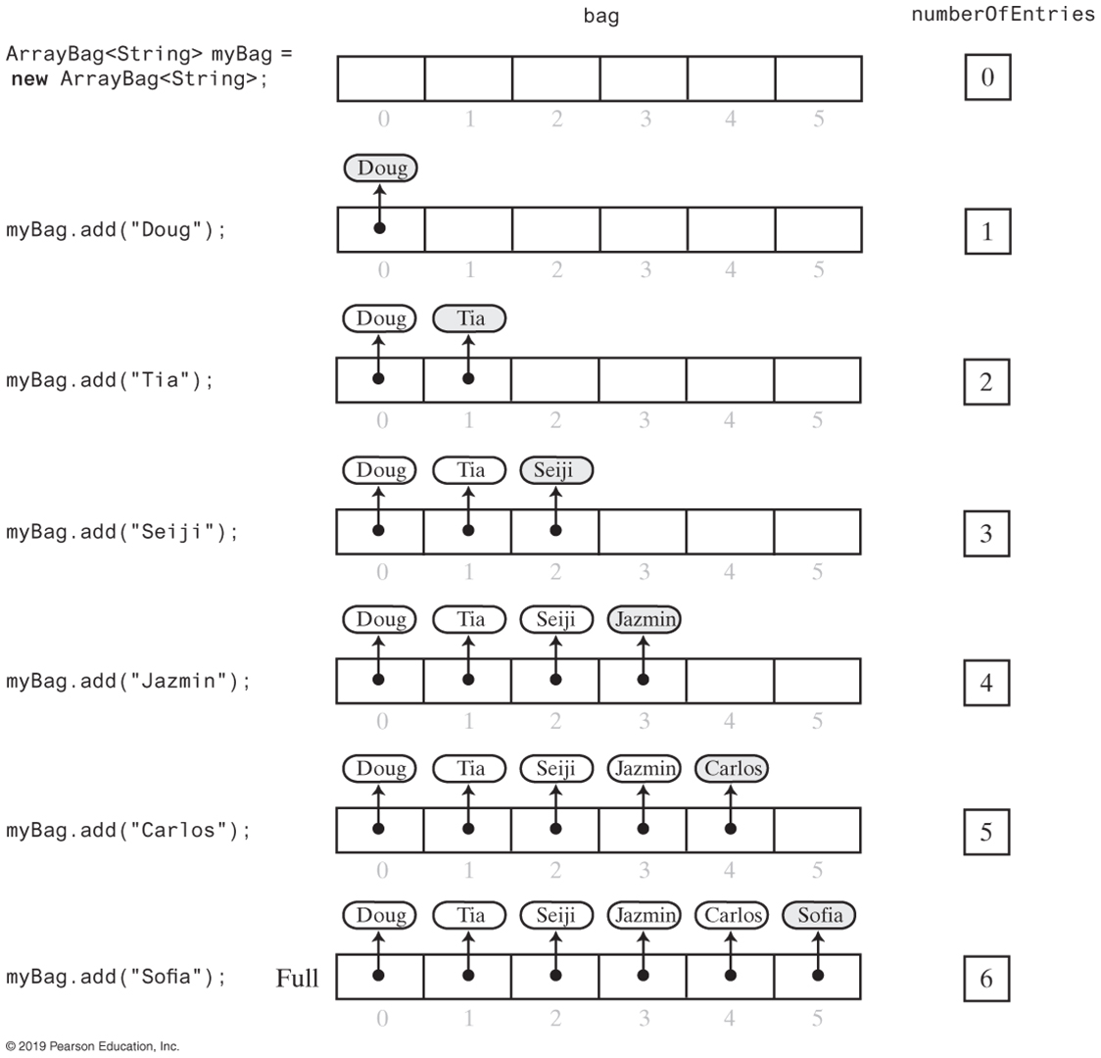
Adding to ArrayBag (1 of 2)
Notes:
This is how we are adding a new item to the Bag. For this example, the Bag holds names (strings)
We can manipulate using an array index (position)

Slide 11
Adding to ArrayBag (2 of 2)
Notes:
Since it’s a fixed-size bag, it will eventually become full
What should we do when the bag is full?

Slide 12
Class ArrayBag (1 of 2)
/**A class of bags whose entries are stored in a fixed-size array.
INITIAL, INCOMPLETE DEFINITION; no security checks */
public final class ArrayBag<T> implements BagInterface<T>
{
private final T[] bag;
private int numberOfEntries;
private static final int DEFAULT_CAPACITY = 25;
/** Creates an empty bag having a given initial capacity.
@param desiredCapacity The integer capacity desired. */
public ArrayBag(int desiredCapacity)
{
// The cast is safe because the new array contains null entries.
@SuppressWarnings("unchecked")
T[] tempBag = (T[])new Object[desiredCapacity]; // Unchecked cast
bag = tempBag;
numberOfEntries = 0;
} // end constructor
Notes:
Class ArrayBag
Starting code of the ArrayBag implementation
Constructor for the ArrayBag()

Slide 13
Class ArrayBag (2 of 2)
/** Adds a new entry to this bag.
@param newEntry The object to be added as a new entry.
@return True if the addition is successful, or false if not. */
public boolean add(T newEntry)
{
// To be defined
} // end add
/** Retrieves all entries that are in this bag.
@return A newly allocated array of all the entries in this bag. */
public T[] toArray()
{
// To be defined
} // end toArray
// Returns true if the array bag is full, or false if not.
private boolean isArrayFull()
{
// To be defined
} // end isArrayFull
} // end ArrayBag
Notes:
Since we are implementing an interface, we need to “stub” out methods so that our code can compile

Slide 14
Method Add()
/** Adds a new entry to this bag.
@param newEntry the object to be added as a new entry.
@return True if the addition is successful, or false if not.*/
public boolean add(T newEntry)
{
boolean result = true;
if (isArrayFull())
{
result = false;
}
else
{ // Assertion: result is true here
bag[numberOfEntries] = newEntry;
numberOfEntries++;
} // end if
return result;
} // end add
Notes:
We will only discuss (highlight) select methods
Watch video notes to continue learning

Slide 15
Making Implementation Secure (1 of 4)
// including additional constraints
private boolean integrityOK = false;
private static final int MAX_CAPACITY = 10000;
Practice fail-safe programming by including checks for anticipated errors
Validate input data and arguments to a method
refine incomplete implementation of ArrayBag to make code more secure by adding the two data fields
Notes:
Why is MAX_CAPACITY needed?
Fail-safe programming is something we need to think about

Slide 16
Making Implementation Secure (2 of 4)
/** Creates an empty bag having a given capacity.
@param desiredCapacity The integer capacity desired. */
public ArrayBag(int desiredCapacity)
{
if (desiredCapacity <= MAX_CAPACITY)
{
// The cast is safe because the new array contains null entries
@SuppressWarnings("unchecked")
T[] tempBag = (T[])new Object[desiredCapacity]; // Unchecked cast
bag = tempBag;
numberOfEntries = 0;
integrityOK = true;
}
else
throw new IllegalStateException("Attempt to create a bag whose" +
"capacity exceeds allowed maximum.");
} // end constructor
Notes:
Actual code to illustrate what we mean

Slide 17
Making Implementation Secure (3 of 4)
// Throws an exception if this object is not initialized.
private void checkIntegrity()
{
if (!integrityOK)
throw new SecurityException("ArrayBag object is corrupt.");
} // end checkIntegrity

Slide 18
Making Implementation Secure (4 of 4)
/** Adds a new entry to this bag.
@param newEntry The object to be added as a new entry.
@return True if the addition is successful, or false if not. */
public boolean add(T newEntry)
{
checkIntegrity();
boolean result = true;
if (isArrayFull())
{
result = false;
}
else
{ // Assertion: result is true here
bag[numberOfEntries] = newEntry;
numberOfEntries++;
} // end if
return result;
} // end add
Notes:
Everyone should code the Bag and then test it

Slide 19
Activity: Testing Core Methods (1 of 3)
/** A test of the constructors and the methods add and toArray,
as defined in the first draft of the class ArrayBag. */
public class ArrayBagDemo1
{
public static void main(String[] args)
{
// Adding to an initially empty bag with sufficient capacity
System.out.println("Testing an initially empty bag with " +
" sufficient capacity:");
BagInterface<String> aBag = new ArrayBag1<>();
String[] contentsOfBag1 = {"A", "A", "B", "A", "C", "A"};
testAdd(aBag, contentsOfBag1);
// Filling an initially empty bag to capacity
System.out.println("\nTesting an initially empty bag that " +
" will be filled to capacity:");
aBag = new ArrayBag1<>(7);
String[] contentsOfBag2 = {"A", "B", "A", "C", "B", "C", "D",
"another string"};
testAdd(aBag, contentsOfBag2);
} // end main
Notes:
Test to ensure that Add() is working; no point to proceed unless Add is working

Slide 20
Activity: Testing Core Methods (2 of 3)
// Tests the method add.
private static void testAdd(BagInterface<String> aBag, String[] content)
{
System.out.print("Adding the following strings to the bag: ");
for (int index = 0; index < content.length; index++)
{
if (aBag.add(content[index]))
System.out.print(content[index] + " ");
else
System.out.print("\nUnable to add " + content[index] +
" to the bag.");
} // end for
System.out.println();
displayBag(aBag);
} // end testAdd

Slide 21
Activity: Testing Core Methods (3 of 3)
// Tests the method toArray while displaying the bag.
private static void displayBag(BagInterface<String> aBag)
{
System.out.println("The bag contains the following string(s):");
Object[] bagArray = aBag.toArray();
for (int index = 0; index < bagArray.length; index++)
{
System.out.print(bagArray[index] + " ");
} // end for
System.out.println();
} // end displayBag
} // end ArrayBagDemo1
Program Output
Testing an initially empty bag with sufficient capacity:
Adding the following strings to the bag: A A B A C A
The bag contains the following string(s):
A A B A C A
Testing an initially empty bag that will be filled to capacity:
Adding the following strings to the bag: A B A C B C D
Unable to add another string to the bag.
The bag contains the following string(s):
A B A C B C D
Notes:
Is your output the same as the provided Program Output?

Slide 22
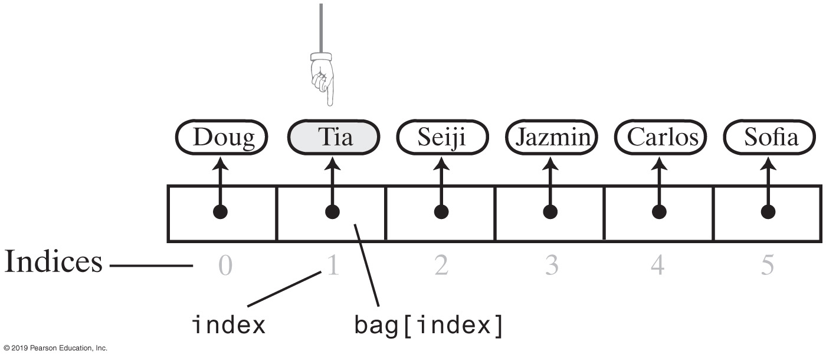
Removing Entries
Notes:
Adding an entry is not too bad, however, you will need to think about removing an entry
Why I am saying that?

Slide 23
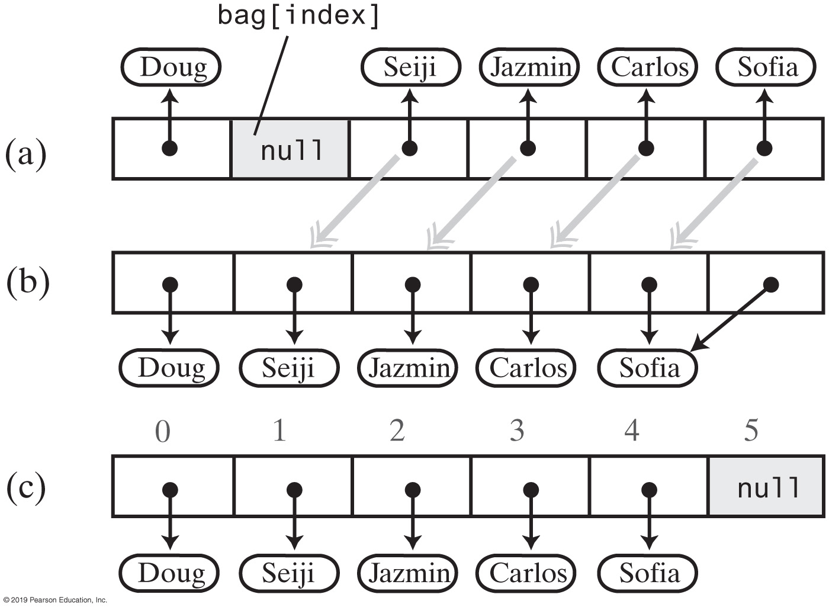
Removing Entries
Notes:
FIGURE 2-5
(a) A gap in the array bag after setting the entry in bag[index] to null
(b) the array after shifting subsequent entries to avoid a gap
(c) after replacing the duplicate reference to the last entry with null
This approach (algorithm) is NOT the most efficient way to delete

Slide 24
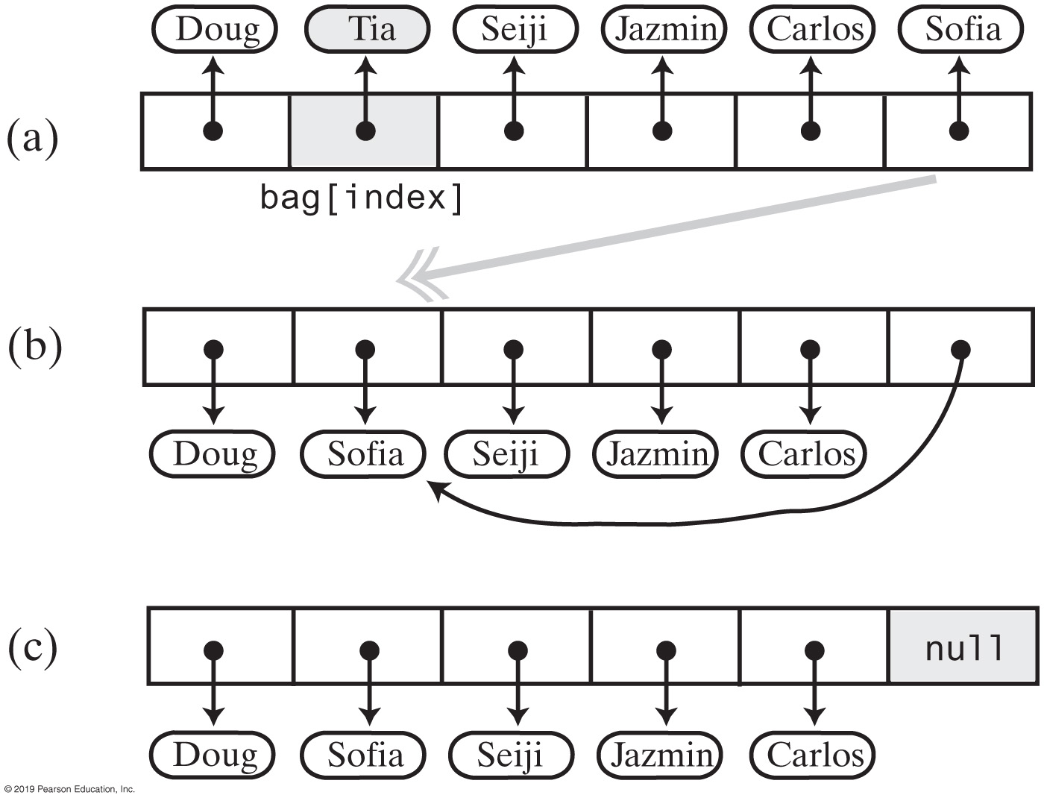
Removing Entries
Notes:
Instead, replace the removed entry with the last entry

Slide 25
Removing Entries
// Removes and returns the entry at a given index within the array bag.
// If no such entry exists, returns null.
// Preconditions: 0 <= givenIndex < numberOfEntries;
// checkIntegrity has been called.
private T removeEntry(int givenIndex)
{
T result = null;
if (!isEmpty() && (givenIndex >= 0))
{
result = bag[givenIndex]; // Entry to remove
bag[givenIndex] = bag[numberOfEntries - 1]; // Replace entry with last entry
bag[numberOfEntries - 1] = null; // Remove last entry
numberOfEntries--;
} // end if
return result;
} // end removeEntry

Slide 26
Removing Entries
/** Removes one unspecified entry from this bag, if possible.
@return Either the removed entry, if the removal was successful,
or null otherwise. */
public T remove()
{
checkIntegrity();
T result = removeEntry(numberOfEntries - 1);
return result;
} // end remove
/** Removes one occurrence of a given entry from this bag.
@param anEntry The entry to be removed.
@return True if the removal was successful, or false if not. */
public boolean remove(T anEntry)
{
checkIntegrity();
int index = getIndexOf(anEntry);
T result = removeEntry(index);
return anEntry.equals(result);
} // end remove
Notes:
Be sure to implement the method

Slide 27
Method getIndexOf()
// Locates a given entry within the array bag.
// Returns the index of the entry, if located, or -1 otherwise.
// Precondition: checkIntegrity has been called.
private int getIndexOf(T anEntry)
{
int where = -1;
boolean found = false;
int index = 0;
while (!found && (index < numberOfEntries))
{
if (anEntry.equals(bag[index]))
{
found = true;
where = index;
} // end if
index++;
} // end while
// Assertion: If where > -1, anEntry is in the array bag, and it
// equals bag[where]; otherwise, anEntry is not in the array
return where;
} // end getIndexOf

Slide 28
Method toArray()
/** Retrieves all entries that are in this bag.
@return A newly allocated array of all
the entries in the bag. */
public T[] toArray()
{
// The cast is safe because the new array
// contains null entries.
@SuppressWarnings("unchecked")
T[] result = (T[])new Object[numberOfEntries]; // Unchecked cast
for (int index = 0; index < numberOfEntries; index++)
{
result[index] = bag[index];
} // end for
return result;
} // end toArray
Notes:
What’s your observation about this method?
Do we really need it?

Slide 29
Learning Activity
Complete the ADT as practice
Textbook includes bits and pieces of code already
1+ upcoming projects will be similar to this
What vs. how
Notes:
Go ahead and implement the Remove()

Slide 30
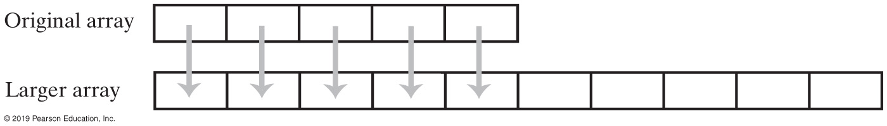
Resizing an Array
When is a (virtual) bag become full?
What should we do?
Notes:
Array’s limitation
Since it’s a fixed size array, we cannot really make the original array bigger
However, we can create a new and bigger array, and then copy the elements from the Original to the newly created Larger array (and copy data from the old one.)

Slide 31
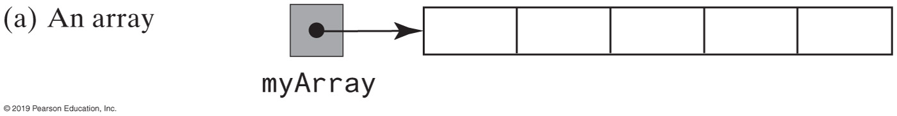
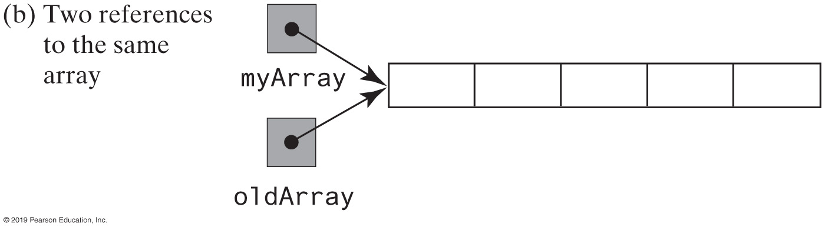
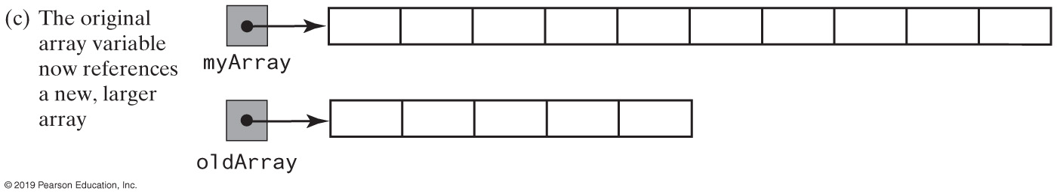
Steps to Resize an Array (1 of 2)
Notes:
Here are the actual steps to resize

Slide 32
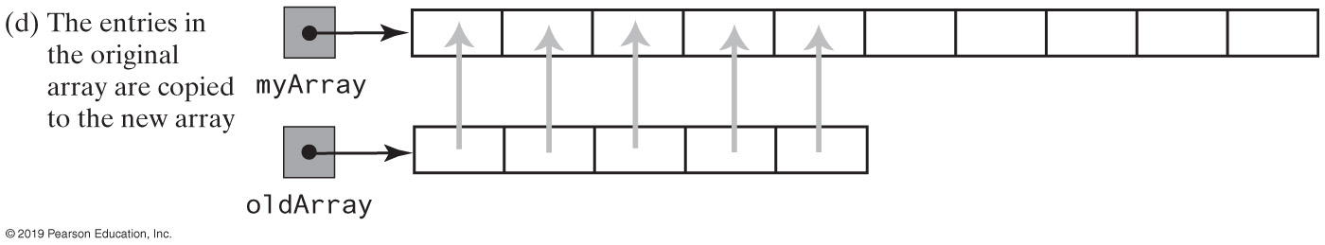
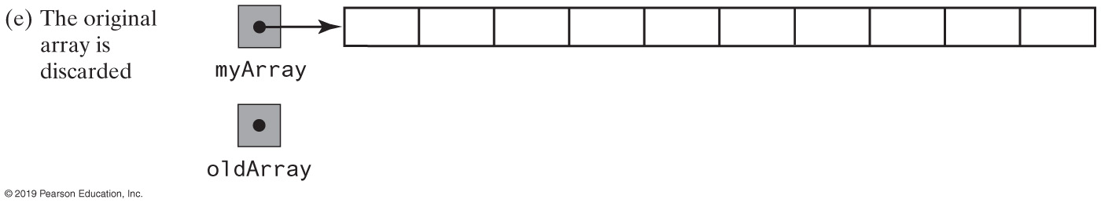
Steps to Resize an Array (2 of 2)

Slide 33
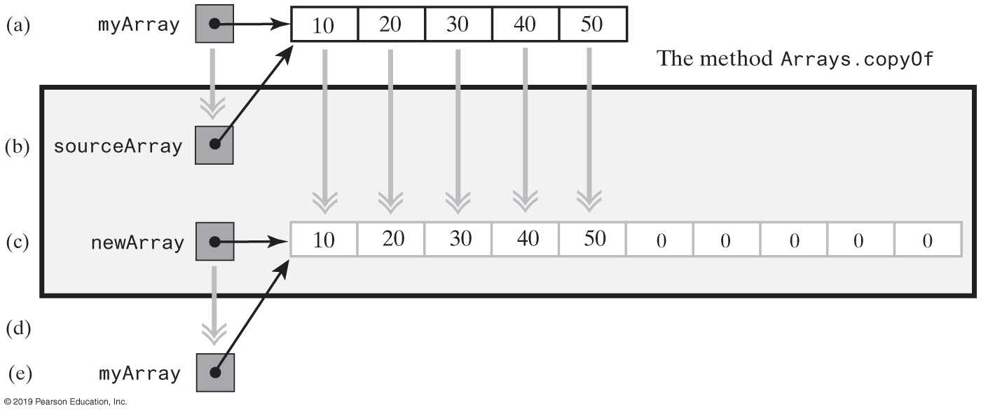
Using Arrays.copyOf
Notes:
Did you know about Arrays.copyOf()?
myArray = Arrays.copyOf(myArray, 2 * myArray.length);

Slide 34
Updated Add Method
/** Adds a new entry to this bag.
@param newEntry The object to be added as a new entry.
@return True. */
public boolean add(T newEntry)
{
checkIntegrity();
boolean result = true;
if (isArrayFull())
{
doubleCapacity();
} // end if
bag[numberOfEntries] = newEntry;
numberOfEntries++;
return true;
} // end add

Slide 35
Array Based Implementation
Pros
Adding an entry to the bag is fast
Removing an unspecified entry is fast
Cons
Removing a particular entry requires time to locate the entry
Increasing the size of the array requires time to copy its entries
Notes:
Do you agree?

Slide 36
Sorted vs. Unsorted Data Structures
Sorted vs. unsorted data
Compare and contrast
Sorted array structures
Nodes are stored in sorted order based on key
getIndexOf uses a binary search
remove
uses getIndexOf with binary search
moves up all node references below the deleted node
add
Places the inserted node in its sorted order position
After moving larger nodes references down in array
Notes:
Trade-offs
Large datasets

Slide 37
Class ArrayList<E> (Java Standard Library)
Interface List<E>
A generic data structure
Supports the basic operations
Stores objects, but primitive types are wrapped automatically in Wrapper objects
Expandable
Client code
ArrayList <Car> garage = new ArrayList<Car> (50)
Initial capacity of 50 Cars (objects, default is a capacity of 10)
37
Notes:
The ArrayList that you have learned in CMSC 203; it has the same behavior and same (under the hood) implementation
<T> vs. <E>

Slide 38
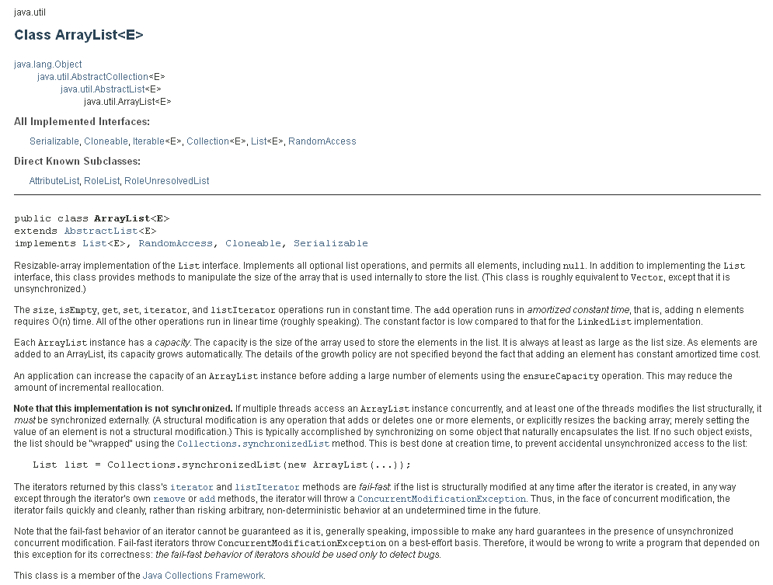
Notes:
This is the JavaDoc of the Class ArrayList<E>
https://docs.oracle.com/javase/8/docs/api/java/util/ArrayList.html

Slide 39
204Mon | In Class Attendance
Reply with a “I was here” post under Discussions
Notes:
You should compare and contrast Set<E> vs. List<E>

